Slide 1


Application for Business Accelerators
Description:
This E-application will provide a proper platform for innovative ideas to transform into a company .
This application will ease the manual process of user by providing following features:
List and contact details of Mentors, technologists
Detailed information about Investors (who they are, their field interest/work)
Requirements: What type of Idea will be funded, Which one will be given priority etc...
Register & Login options for entrepreneurs.
Once registered, entrepreneur can submit idea along with details for review.
After registering, individual will have access to list of other members who have registered there too.
A chat room for entrepreneurs(registered members).
Regular updates of video lectures by mentors for registered members.
A separate option where approved ideas by investors will be shown and it will be open to see by all.

Slide 2
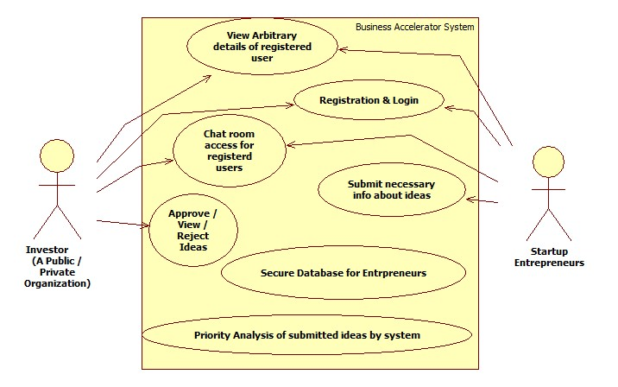
A simple Use-Case Diagram of proposed system

